Slide 1


 | Nitte Meenakshi Institute of Technology (AN AUTONOMOUS INSTITUTION AFFILIATED TO VISVESVARAYA TECHNOLOGICAL UNIVERSITY, BELGAUM) PB No. 6429, Yelahanka, Bangalore 560-064, Karnataka Telephone: 080- 22167800, 22167860, Fax: 080 - 22167805
Department of Computer Science and Engineering
E-Voting System using Blockchain and Homomorphic Encryption
18PCS_07
Presentation By:
Prateek G - 1NT18CS117
Sheetal S Harshini - 1NT18CS149
Shreya A Hegde - 1NT18CS153
V Venkata Sree Harsha - 1NT18CS181
Guided By:
Mr Ramesh Naidu
Assistant Professor, Dept. of CSE

Slide 2

Why vote?
The right to vote, one of the most enshrined rights protected by constitutions, has been the fundamental basis of democracy.[8]

Slide 3

Problems with the traditional voting system
Security
Ballot forgery
Coercion
Transparency
Centralized System
Possibility to tamper with the database
[1], [6], [9]

Slide 4

So what’s the solution?

Slide 5

Proposed System
Eligibility Status
E-Voting
Blockchain
Homomorphic Encryption

Slide 6

Advantages of said System
Secure transmission of the ballot
Decentralized System
[2]

Slide 7
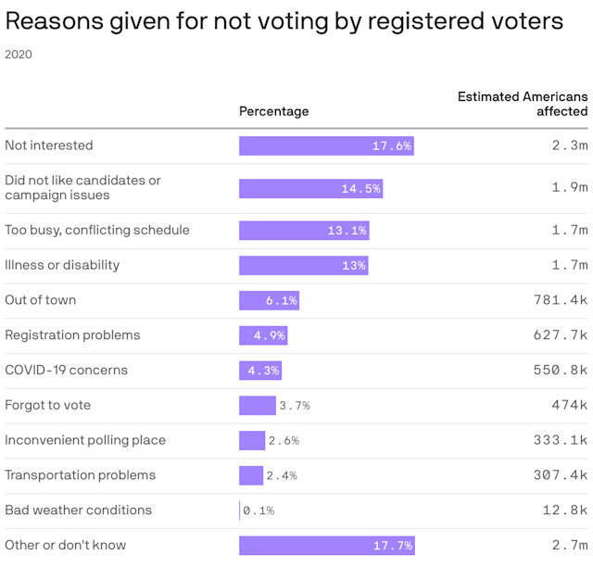

Slide 8

Advantages of said System
Potential to increase the participation of citizens in the democratic process [2]

Slide 9
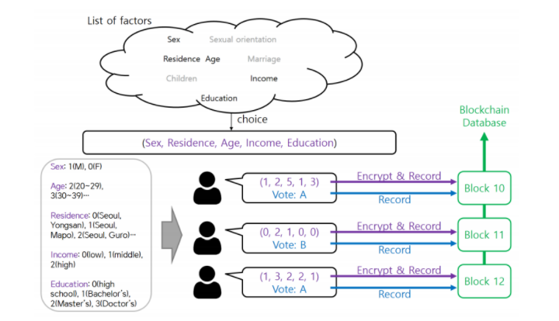
Advantages of said System
Fig 1 - Choosing Features to Perform Statistical Analysis [4]

Slide 10

Advantages of said System
Visualization of election data
Unique and valuable insights
[7]

Slide 11

What is Homomorphic Encryption?
Data computations on encrypted data
Results of computations is also encrypted

Slide 12

Why Homomorphic Encryption?
Enables collaboration.
Enables regulatory compliance.

Slide 13
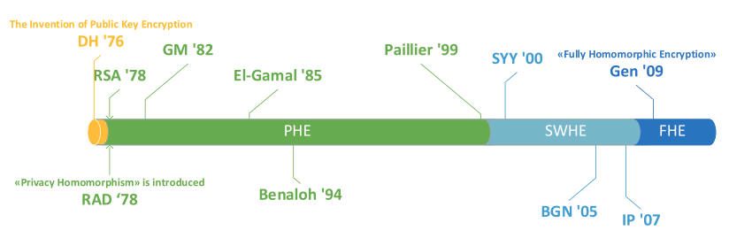
How many types are there?
PHE - Paillier ‘99 [24][26]
SWHE - [16]

Slide 14
How many FHE schemes are there?
Gentry’s Scheme[14]
DGHV (Dijk-Gentry-Haveli-Vaikuntanathan)[8]
BGV (Brakerski-Gentry-Vaikuntanathan)[15][25]
BFV (Brakerski-Fan-Vercauteren)[16][17][25]
GSW (Gentry-Sahai-Waters)[19]

Slide 15

Common Libraries
GH [20]
HElib[21]
SEAL[22]

Slide 16

Paillier Algorithm
Electronic voting system using Paillier algorithm with its homomorphic property.[28]
This system guarantees data confidentiality and utilizes homomorphic properties of the algorithm [17] [18]

Slide 17
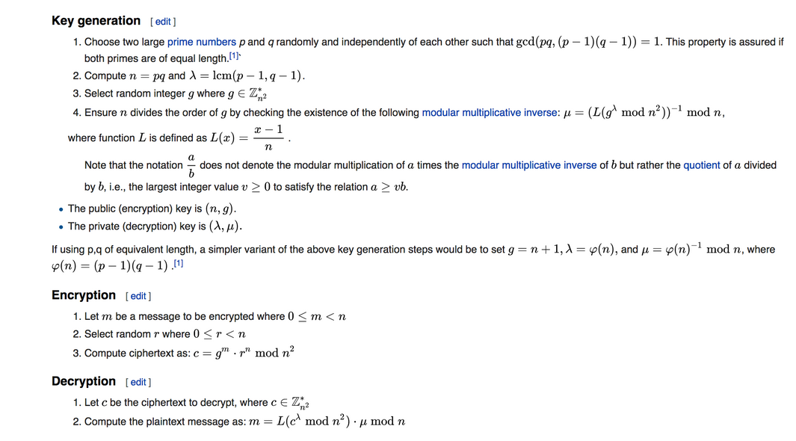
Paillier Algorithm [43]

Slide 18
Paillier Algorithm On Homomorphic Encryption
Multiplication of a ciphertext with another plaintext [25]
Addition on two or more ciphertexts[28]
Generate public/private key pair[23]
Encrypt numbers [23]
Decrypt numbers[23]
Saving and loading data (keys and encrypted numbers) [29]

Slide 19
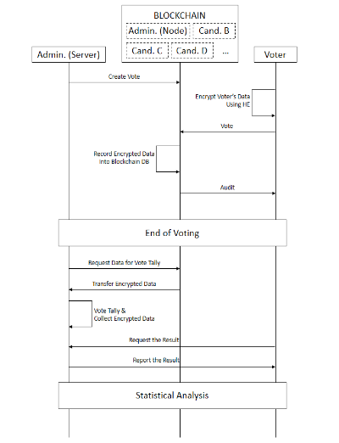
Concept of the e-Voting System

Slide 20
References
[1] R. Hanifatunnisa and B. Rahardjo, "Blockchain based e-voting recording system design," 2017 11th International Conference on Telecommunication Systems Services and Applications (TSSA), 2017, pp. 1-6, doi: 10.1109/TSSA.2017.8272896.
[2] Lemuria Carter and France Bélanger. 2012. Internet voting and political participation: an empirical comparison of technological and political factors. SIGMIS Database 43, 3 (August 2012), 26–46. DOI:https://doi.org/10.1145/2351848.2351851
[3] Pranav More, Rohit Nawale, Reena Kharat, Mohit Nakhale, Kaustubh Patil. E2E VERIFIABLE BLOCKCHAIN VOTING SYSTEM USING HOMOMORPHIC ENCRYPTION. JCR. 2020; 7(19): 1120-1127. doi:10.31838/jcr.07.19.139
[4] Kim, Hyunyeon, Kyung Eun Kim, Soohan Park and Jong-Mo Sohn. “E-voting System Using Homomorphic Encryption and Blockchain Technology to Encrypt Voter Data.” ArXiv abs/2111.05096 (2021): n. pag.

Slide 21
References
[5] Kumar, Kailash & Sharma, Avinash. (2019). E-Voting in India Using Blockchain and It’s Modus Operandi. Journal of Computational and Theoretical Nanoscience. 16. 3774-3777. 10.1166/jctn.2019.8249.
[6] Bishop, Sylvia, and Anke Hoeffler. “Free and Fair Elections: A New Database.” Journal of Peace Research, vol. 53, no. 4, Sage Publications, Ltd., 2016, pp. 608–16, http://www.jstor.org/stable/43920613.
[7] Gupta, Kuhu & Sampat, Shailaja & Sharma, Manas & Rajamanickam, Venkatesh. (2016). Visualization of election data: Using interaction design and visual discovery for communicating complex insights. JeDEM - eJournal of eDemocracy and Open Government. 8. 59-86. 10.29379/jedem.v8i2.422.
[8] Sadia, Kazi, Md. Masuduzzaman, Rajib Kumar Paul and Anik Islam. “Blockchain-Based Secure E-Voting with the Assistance of Smart Contract.” (2020).

Slide 22
References
[9] Tas, Ruhi and Ömer Özgür Tanriöver. “A Systematic Review of Challenges and Opportunities of Blockchain for E-Voting.” Symmetry 12 (2020): 1328.
[10] Jafar, U.; Aziz, M.J.A.; Shukur, Z. Blockchain for Electronic Voting System—Review and Open Research Challenges. Sensors 2021, 21, 5874. https://doi.org/10.3390/s21175874
[11] Tan, W., Zhu, H., Tan, J., Zhao, Y., Xu, L. D., & Guo, K. (2021). A novel service level agreement model using blockchain and smart contract for cloud manufacturing in industry 4.0. Enterprise Information Systems, 1–26. doi:10.1080/17517575.2021.1939426
[12] S. Hakak, W. Z. Khan, G. A. Gilkar, M. Imran and N. Guizani, "Securing Smart Cities through Blockchain Technology: Architecture, Requirements, and Challenges," in IEEE Network, vol. 34, no. 1, pp. 8-14, January/February 2020, doi: 10.1109/MNET.001.1900178.

Slide 23
References
[13] Gentry, C. (2009). Fully homomorphic encryption using ideal lattices. Proceedings of the 41st annual ACM symposium on Symposium on theory of computing-STOC ’09. Vol. 9.
[14] Brakerski, Z., Gentry, C., & Vaikuntanathan, V. (2014). (Leveled) fully homomorphic encryption without bootstrapping. ACM Transactions on Computation Theory (TOCT), 6(3), 13.
[15] Van Dijk, M., Gentry, C., Halevi, S., & Vaikuntanathan, V. (2010, May). Fully homomorphic encryption over the integers. In Annual International Conference on the Theory and Applications of Cryptographic Techniques (pp. 24-43). Springer, Berlin, Heidelberg.
[16] Fan, J., & Vercauteren, F. (2012). Somewhat Practical Fully Homomorphic Encryption. IACR Cryptology ePrint Archive, 2012, 144.

Slide 24
References
[17] Brakerski, Z. (2012). Fully homomorphic encryption without modulus switching from classical GapSVP. In Advances in cryptology–crypto 2012 (pp. 868-886). Springer, Berlin, Heidelberg.
[18] Gentry, C. (2013). Homomorphic Encryption from Learning with Errors: Conceptually Simpler, Asymptotically-Faster, Attribute-Based. CRYPTO Santa Barbara 2013.
[19] Gentry, C., Sahai, A., & Waters, B. (2013). Homomorphic encryption from learning with errors: Conceptually-simpler, asymptotically-faster, attribute-based. In Advances in Cryptology–CRYPTO 2013 (pp. 75-92). Springer, Berlin, Heidelberg.
[20] Gentry, C., & Halevi, S. (2011, May). Implementing gentry’s fully-homomorphic encryption scheme. In Annual international conference on the theory and applications of cryptographic techniques (pp. 129-148). Springer, Berlin, Heidelberg.

Slide 25
References
[21] Halevi, S., & Shoup, V. (2014, August). Algorithms in helib. In International Cryptology Conference (pp. 554-571). Springer, Berlin, Heidelberg.
[22] Simple Encrypted Arithmetic Library (release 3.1.0). Microsoft Research, Redmond, WA
[23] Cheon, J. H., Kim, A., Kim, M., & Song, Y. (2017, December). Homomorphic encryption for arithmetic of approximate numbers. In International Conference on the Theory and Application of Cryptology and Information Security (pp. 409-437). Springer, Cham.
[24] N. Kakade and U. Patel, "Secure Secret Sharing Using Homomorphic Encryption," 2020 11th International Conference on Computing, Communication and Networking Technologies (ICCCNT), 2020, pp. 1-7, doi:10.1109/ICCCNT49239.2020.9225325.

Slide 26
References
[25] Y. Yamada, K. Rohloff and M. Oguchi, "Homomorphic Encryption for Privacy-Preserving Genome Sequences Search," 2019 IEEE International Conference on Smart Computing (SMARTCOMP), 2019, pp. 7-12, doi: 10.1109/SMARTCOMP.2019.00021.
[26] S. Behera and J. R. Prathuri, "Application of Homomorphic Encryption in Machine Learning," 2020 2nd PhD Colloquium on Ethically Driven Innovation and Technology for Society (PhD EDITS), 2020, pp. 1-2, doi: 10.1109/PhDEDITS51180.2020.9315305.
[27] S. Gupta and G. Arora, "Use of Homomorphic Encryption with GPS in Location Privacy," 2019 4th International Conference on Information Systems and Computer Networks (ISCON), 2019, pp. 42-45, doi: 10.1109/ISCON47742.2019.9036149.
[28] Shifa Manaruliesya Anggriane, 3 Surya Michrandi Nasution, 3 Fairuz Azmi 123 Electrical Engineering Faculty Telkom University Bandung, Indonesia

Slide 27
References
[29] D.Chandravathi 1 , Prof.P.V.Lakshmi2 1 GVP College for Degree & PG Courses (A), Rushikonda, Visakhapatnam-45. 2 GITAM University, Rushikonda, Visakhapatnam-45.
[30] K Muhammad1 , K A Sugeng1,* and H Murfi1 1 Department of Mathematics, Universitas Indonesia, Kampus UI Depok, Depok 16424, INDONESIA
[31] DeapSECURE Lesson 5: Cryptography for Privacy-Preserving Computation: Paillier Cryptosystem for Homomorphic Encryption
[32] Haibo Yi, Securing e-voting based on blockchain in P2P network.(2019)
doi:10.1186/s13638-019-1473-6.

Slide 28
References
[33] Kun Peng and Feng Bao,Efficient Multiplicative Homomorphic E-Voting
,Institute for Infocomm Research, Singapore,(2011),doi:10.1007/978-3-642-18178-8_32
[34]Paul Cuff - Sanjeev Kulkarni - Mark Wang - John Sturm,Voting Research - Voting Theory , princeton.edu/~cuff/voting/theory.html.
[35]Xing Shu Li1 , Hyang ran Lee1 , Malrey Lee1 and Jae-young Choi2,A Study of Vulnerabilities in E-Voting System,Conference Paper · May 2015,doi:10.14257/astl.2015.95.25
[36]makeuseof.com/tag/how-electronic-voting-works,How Electronic voting works: pros and cons vs. Paper voting.

Slide 29
References
[37]Sarah Diamond,Are You Voting "No" to Paper Ballots?.
[38]Uzma Jafar * , Mohd Juzaiddin Ab Aziz and Zarina Shukur,Blockchain
for Electronic Voting System—Review and Open Research Challenges,(2021),doi:10.3390/ s21175874
[39] Ruhi Taş and Ömer Özgür Tanrıöver,A Manipulation Prevention Model for Blockchain-Based E-Voting Systems,(2021),doi:10.1155/2021/6673691
[40] Liudmila Babenko and Ilya Pisarev,Distributed E-Voting System Based On Blind Intermediaries Using Homomorphic Encryption,(2018) Article No.: 6 pp.1–6,doi:10.1145/3264437.3264473

Slide 30
References
[41]Namrata Patel, Parita Oza and Smita Agrawal,Homomorphic Cryptography and Its Applications in Various Domains (2019),doi:10.1007/978-981-13-2324-9_2
[42]Nir Kshetri; Jeffrey Voas,Blockchain-Enabled E-Voting
Page(s): 95 - 99,Date of Publication: 06 July 2018,DOI: 10.1109/MS.2018.2801546
[43] https://asecuritysite.com/encryption/pal_ex

Slide 31
Thank you!

